Slide 1

Waves (Transverse and Longitudinal)
Ejalo academy

Slide 2

Medium

Slide 3
Medium
Medium carries the wave from one place to another. The medium does not create the wave and the medium is not the wave.

Slide 4
Medium
Medium carries the wave from one place to another. The medium does not create the wave and the medium is not the wave.
Air is a medium for sound waves, water is a medium for water waves and rock is a medium for earthquakes (which are also a type of wave). Air, water and rock are therefore examples of media (media is the plural of medium).

Slide 5
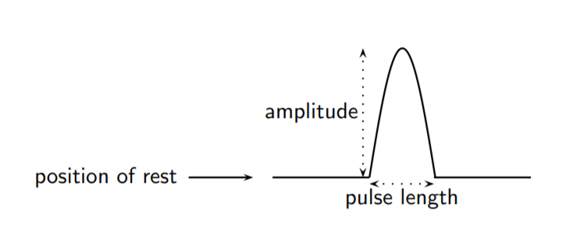
Amplitude

Slide 6
Superposition of Pulses
Two or more pulses can pass through the same medium at that same time. The resulting pulse is obtained by using the principle of superposition. The principle of superposition states that the effect of the pulses is the sum of their individual effects

Slide 7

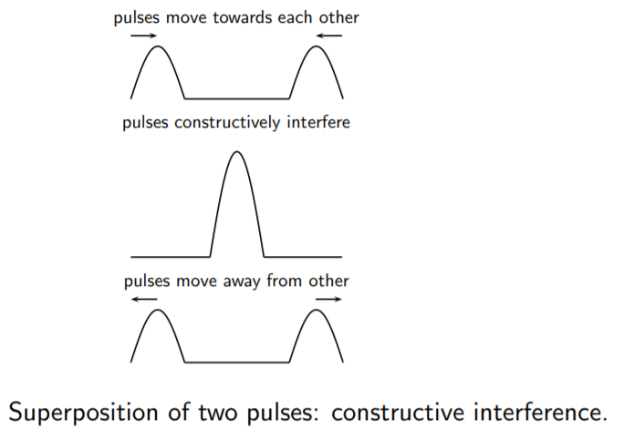
Constructive Interface

Slide 8
Deconstructive Interface

Slide 9
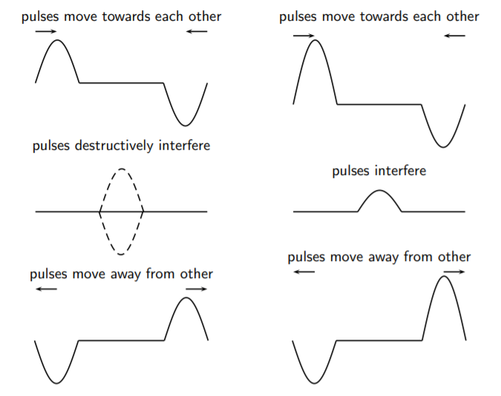
Deconstructive Interface

Slide 10

Waves

Slide 11
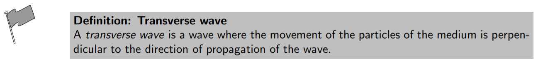
Waves

Slide 12

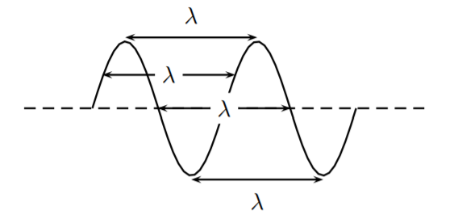
Wavelength of wave

Slide 13
Wavelength of wave

Slide 14

Period and Frequency

Slide 15


Period and Frequency

Slide 16
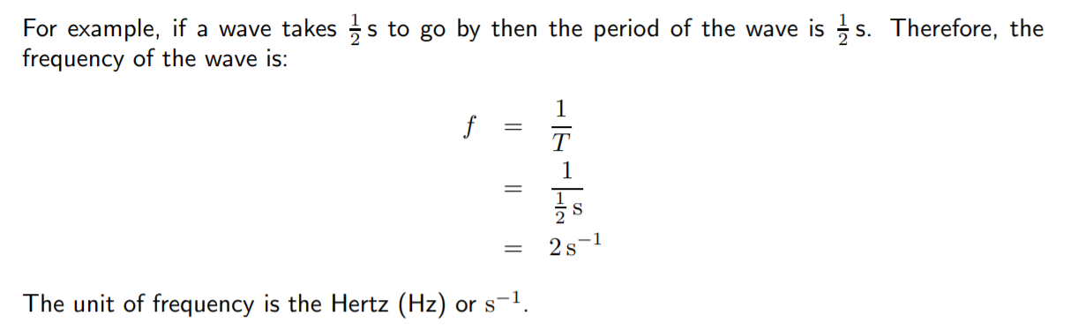
Period and Frequency

Slide 17
Exercise: Period and Frequency
Question : What is the period of a wave of frequency 10 Hz?

Slide 18
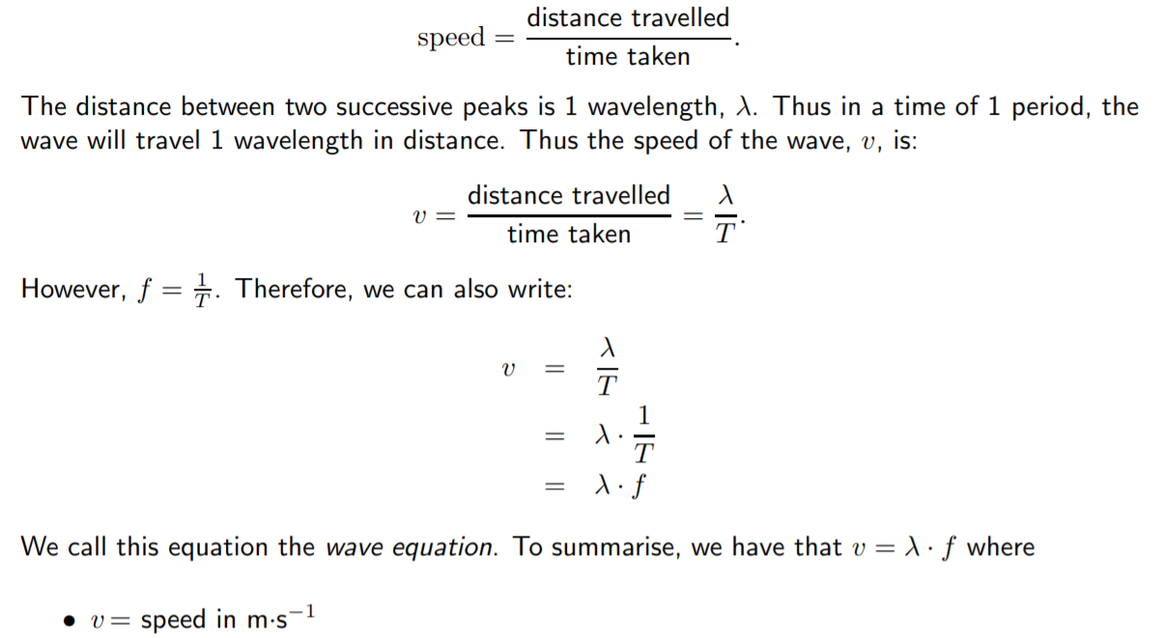
Speed of Transverse wave

Slide 19
Exercise: Speed of a Transverse Wave
Question: When a particular string is vibrated at a frequency of 10 Hz, a transverse wave of wavelength 0,25 m is produced. Determine the speed of the wave as it travels along the string.

Slide 20

Longitudinal Waves

Slide 21
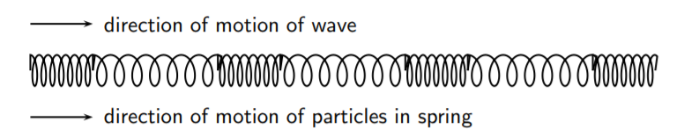
Longitudinal Waves

Slide 22
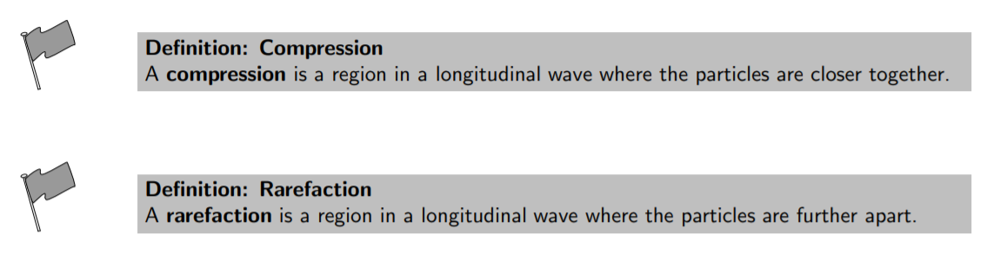
Characteristics of Longitudinal Waves

Slide 23
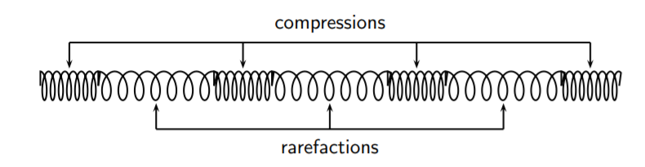
Characteristics of Longitudinal Waves

Slide 24
Characteristics of Longitudinal Waves

Slide 25

Wavelength and Amplitude

Slide 26

Wavelength and Amplitude

Slide 27
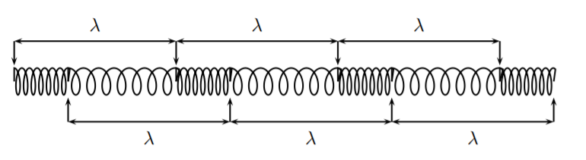
Wavelength and Amplitude
Wavelength of a longitudinal wave

Slide 28
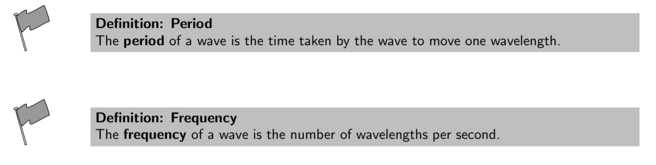
Wavelength and Amplitude

Slide 29

Wavelength and Amplitude

Slide 30
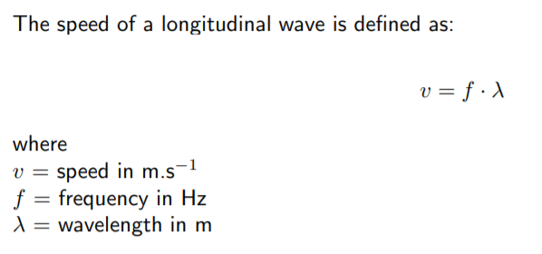
Speed of longitudinal waves

Slide 31
Example: Speed of longitudinal waves
Question: The musical note A is a sound wave. The note has a frequency of 440 Hz and a wavelength of 0,784 m. Calculate the speed of the musical note.

Slide 32
Example: Speed of longitudinal waves
Question: The musical note A is a sound wave. The note has a frequency of 440 Hz and a wavelength of 0,784 m. Calculate the speed of the musical note.

Slide 33
Sound waves
Sound waves coming from a tuning fork cause the tuning fork to vibrate and push against the air particles in front of it. As the air particles are pushed together a compression is formed. The particles behind the compression move further apart causing a rarefaction. As the particles continue to push against each other, the sound wave travels through the air.

Slide 34
Sound waves
Sound waves coming from a tuning fork cause the tuning fork to vibrate and push against the air particles in front of it. As the air particles are pushed together a compression is formed. The particles behind the compression move further apart causing a rarefaction. As the particles continue to push against each other, the sound wave travels through the air.
Due to this motion of the particles, there is a constant variation in the pressure in the air. Sound waves are therefore pressure waves. This means that in media where the particles are closer together, sound waves will travel quicker.

Slide 35
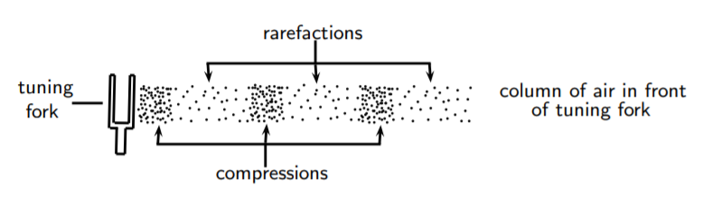
Sound waves
Sound waves travel faster through liquids, like water, than through the air because water is denser than air (the particles are closer together). Sound waves travel faster in solids than in liquids.

Slide 36
Sound waves
Sound waves travel faster through liquids, like water, than through the air because water is denser than air (the particles are closer together). Sound waves travel faster in solids than in liquids.

Slide 37
Seismic waves
Seismic waves are waves from vibrations in the Earth (core, mantle, oceans). Seismic waves also occur on other planets, for example the moon and can be natural (due to earthquakes, volcanic eruptions or meteor strikes) or man-made (due to explosions or anything that hits the earth hard). Seismic P-waves (P for pressure) are longitudinal waves which can travel through solid and liquid.

